Slide 1


Educational Platform with Courses
DEVELOPED BY
Parth Patel(2203051050759)
Mit Parmar (2203051050347)
Prerna Solanki(2203051050014)
Harsh Bosamiya (2203051050211)
Mohit Jobanputra (2203051050740)
GUIDED BY:- MR.MAKSUD VHORA

Slide 2
Our Mission: Empowering Lifelong Learners
We believe that learning should be accessible to everyone, regardless of age, background, or location.
Our platform provides a diverse range of high-quality courses, taught by experienced and credentialed instructors.
We are revolutionizing education by making learning more accessible, engaging, and tailored to your unique needs.
Whether you’re a student aiming for academic excellence, a professional looking to upskill, or a hobbyist exploring new passions, we’re here to help you thrive.

Slide 3
What We Offer:
Diverse Courses: Explore a wide range of topics, from technology and business to arts and personal development.
Expert Instructors: Learn from industry professionals and experienced educators who are passionate about teaching.
Interactive Learning: Enjoy multimedia-rich content, quizzes, and practical projects to enhance your understanding.
Flexible Schedules: Study anytime, anywhere, and tailor your learning journey to fit your lifestyle.
Community Support: Join a global community of learners and participate in discussions, group projects, and peer reviews.

Slide 4





Interactive Learning Experiences
Engaging Videos
Interactive Quizzes
Community Forums
Practical Projects
High-quality video lectures from leading instructors.
Test your knowledge with engaging quizzes and assessments.
Connect with other learners and share your experiences.
Apply your knowledge with hands-on projects and assignments.

Slide 5

Personalized Learning Paths
1
Our platform analyzes your interests and goals.
2
It then suggests a tailored learning path with relevant courses.
3
You can track your progress, earn badges, and achieve your learning goals.

Slide 6
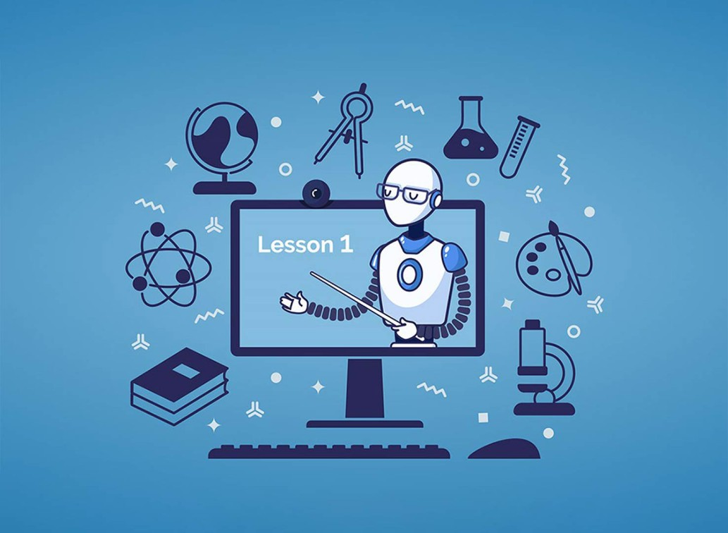
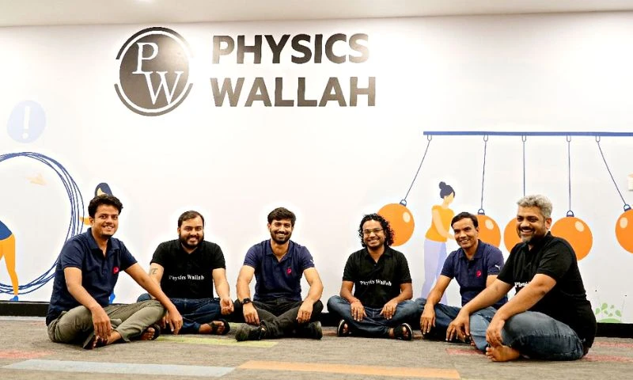
Credentialed Instructors
Industry Experts
Passionate Educators
Our instructors are experts in their fields, with years of experience and proven credentials.
They are passionate about teaching and committed to helping you succeed.

Slide 7
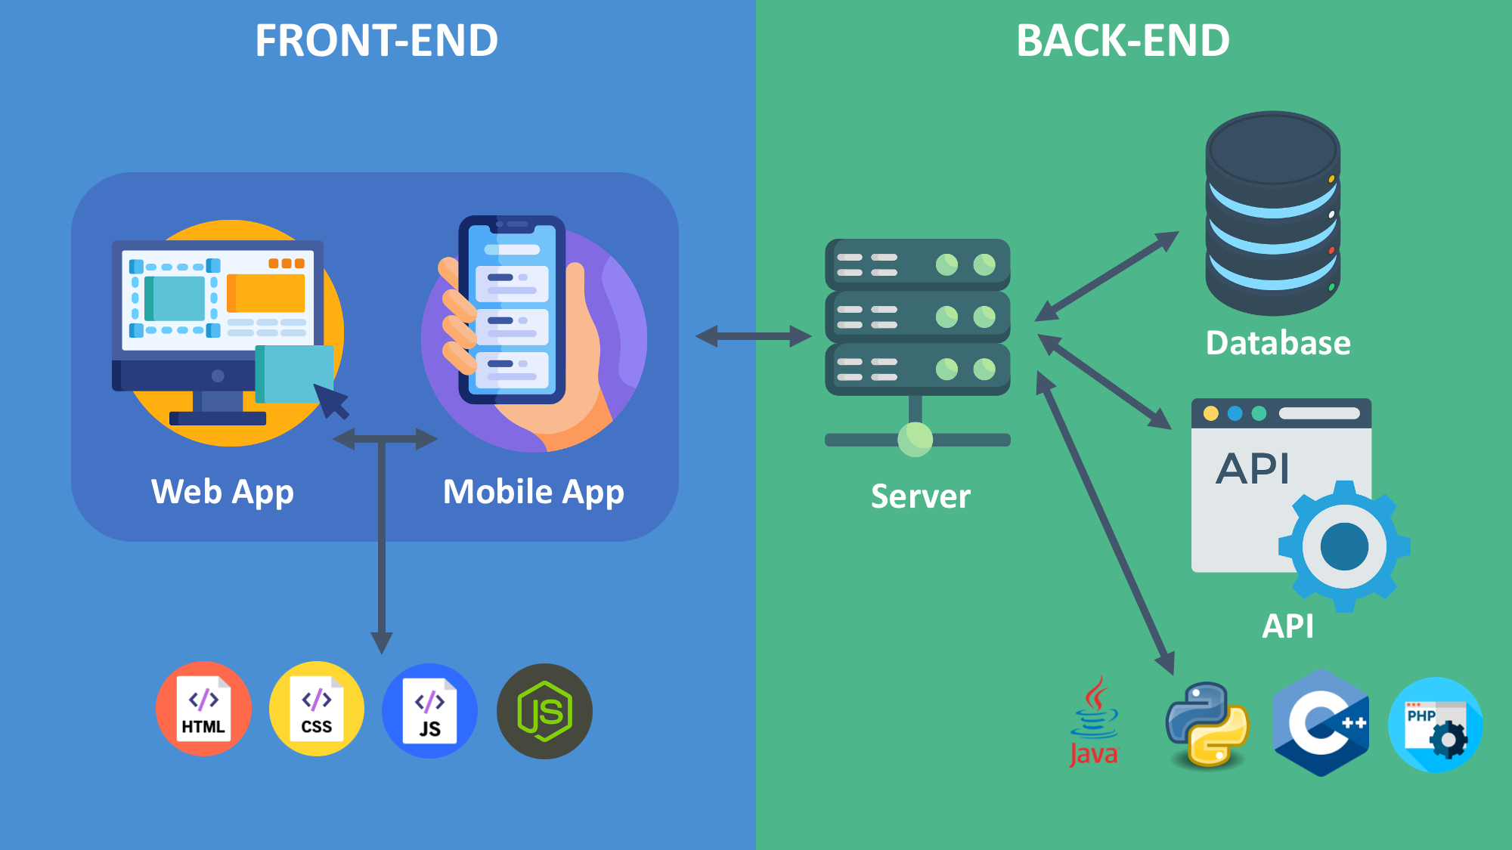
TECHNOLOGIES USED:
FRONT END:
1.)HTML
2.)CSS
3.)JAVA SCRIPT
4.)REACT JS
5.)ANGULAR JS
BACK END:
1.)DATABASES
2.)NODE JS
3.)PYTHON
4.)EXPRESS JS
5.)DJANGO FRAMEWORKS

Slide 8

Flexible Learning Options
Self-paced learning
Live sessions
Learn at your own pace, on your own schedule.
Engage with instructors and other learners in real-time.
Mobile access
Learn anywhere, anytime, with our mobile app.

Slide 9




Seamless Mobile Experience
Access courses
Browse and enroll in courses from anywhere.
Track progress
Monitor your learning progress and stay motivated.
Engage with instructors
Ask questions and receive personalized support.

Slide 10

BENEFITS FOR STUDENTS:
Live chat –Get instant help from our support team.
Email support- Contact us anytime with your questions.
Online resources-Access a comprehensive knowledge base and FAQs.
Regular updates-We're constantly improving our platform based on user feedback.
New features-We're always adding new features to enhance your learning experience.
Ongoing innovation-We're committed to providing the best possible learning experience.

Slide 11
REFERENCES:
1.) https://www.google.com/url?sa=i&url=https%3A%2F%2Fduaspotli.com%2Fe-learning-platform-for-students-newtown%2F&psig=AOvVaw21X4EHrbQQTpaD1noyFVuv&ust=1736237482795000&source=images&cd=vfe&opi=89978449&ved=0CBQQjRxqFwoTCKD8qefS4IoDFQAAAAAdAAAAABAZ
2.) https://www.google.com/url?sa=i&url=https%3A%2F%2Fmedium.com%2F%40adityagaba1322%2Fstreamlining-backend-frontend-integration-a-quick-guide-145eca3cca05&psig

